Slide 1

LIFESAVING WORLD CHAMPIONSHIPS 2024
TECHNICAL OFFICIALS BRIEFING – BEACH AND OCEAN

Slide 2
The ILS Event Management Committee and the Local Organising Committee records their appreciation and thanks you for officiating at the Lifesaving World Championships (LWC) 2024
Gold Coast, Queensland
Australia
WELCOME

Slide 3
ILS Event Management Committee
Dave THOMPSON – Chairman
Jelle MEINTSMA – Secretary
Greg ALLUM – Ocean Championships
Perry SMITH – Pool Championships
Wim NUYENS – LifeHeats, Entries and Results
For any assistance, questions or enquiries – Please ask

Slide 4
LWC 2024: Local Organising Committee
Ron RANKIN – Chair and Project Director
Jacqui TAYLOR – Event Manager
Craig WILLIAMS – Assistant Event Manager/Pool Technical Advisor
Allan INWOOD - Ocean Technical Advisor
Ken BIRD – Site Manager & Logistics
Steve LEAHY – Director Safety & EMS
Nathan FIFE – Deputy Director Safety & EMS

Slide 5
Ocean & Beach Referees and Senior Officials
POSITION | MASTERS OCEAN | NT OCEAN | IC OCEAN & MARCH PAST | SURF BOAT | IRB
CHIEF REFEREE | Don VAN KEIMPEMA | Carolyn WILSON | John BRENNAN | Tony HAVEN | Mal FLEW
DEPUTY REFEREE | Peter CONNELL David UNGER Andrea PENNELL | Arno EBERLE Don VAN KEIMPEMA | Jenny MILLER Peter CONNELL Carolyn WILSON | Charles MELLOY Peter VAN DUUREN | Wim NUYENS N/T Nigel PENN - N/T & IC Michael COOK IC
SECTIONAL REFS | Richard CROWE Jeff MOWBRAY Jenny MILLER Peter CARNEY Kylie INNES | Peter CARNEY Jenny MILER Paul D’EON Rachel SOARS John BARWOOD | David UNGER Shayne BAKER Jenny KENNY Peter CARNEY Heather THOMPSON John HAMREY (MP) | David HARDGREAVES Mick LANG
LIAISON | Peter THOMAS Roger LLOYD Heather THOMPSON Warren MASSEY Graham RICE | Heather THOMPSON David UNGER Peter CONNELL Graham RICE | Warren MASSEY Barbara MORGAN Graham RICE Glen JONES Gavin MARSHALL Robert THOMPSON Kurt GOODWIN | Jennifer DRURY Jeff HEWITT Phil LYTHAM John ROBINSON | Terry BOARDMAN Lisa HAPP Ronald VAN VLIET Uri TEITLER
APPEALS COMMITTEE CONVENOR | Mike MARTIN | Mike MARTIN | Mike MARTIN | Mike MARTIN | Mike MARTIN

Slide 6
Other Officials
The appointment of the remaining positions are on the LWC 2024 website. There have been some changes, and the appointment schedules will be updated.

Slide 7
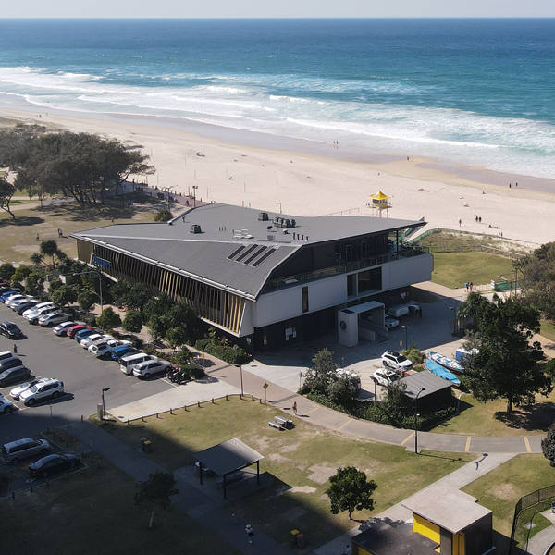
Kurrawa SLSC and Beach

Slide 8
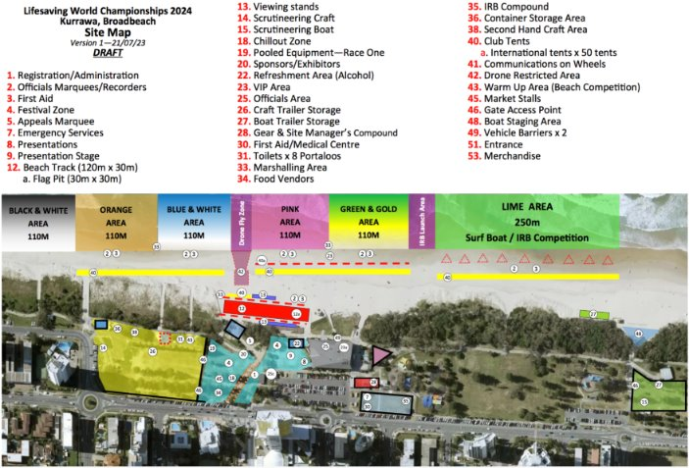
Beach Layout

Slide 9
ILS ANTI-DOPING POSITION
ILS shares the World Anti-Doping Agency (WADA) vision of a world where athletes can participate in a doping-free sporting environment.
ILS and its member federations/organisations are committed to adhere to WADA Standards and seeks to provide a clean, safe, and fair sporting environment.
A key principle of WADA’s World Anti-Doping Code International Standard for Education (ISE) is that the first encounter with clean sport and anti-doping should be for all athletes to be educated before being tested.
To this end ILS provides comprehensive information and education advice to its members via its website.
Sport Integrity Australia (SIA), a WADA recognised National Anti-Doping Agency, will be present during these Championships and, in line with WADA standards, there may be both random and targeted anti-doping testing in all 2024 LWCs.
Note: For the World Games in 2025 and for LWC2026 ILS will require national teams to have undertaken formal anti - doping education prior to participation in competition.

Slide 10
Blue Cards
The Queensland Government has enacted legislation with the purpose that “all children under the age 18 years have a right to be safe and protected from harm”.
The “Blue Card” system contributes to the creation of safe service environments for children and includes a check on all adults who will work with children for seven days or more in a calendar year. This timeframe includes all ILS and SLS activities in Queensland including LWC2024.
All Australian Officials and Team Management at LWC2024 should have obtained a Blue Card. This requirement will be checked by the Local Organising Committee (LOC) as part of your registration at LWC2024.
If not already obtained, please arrange ASAP and, if possible, please ensure you have your blue card number when registering at LWC2024.
For non-Australian Team Management, the Local Organising Committee has requested a declaration from their Federation to ILS that their members are “safe” to work with children. The LOC has a record of these declarations.

Slide 11
Transport
There is excellent public transport including trams and buses on the Gold Coast including between Kurrawa Beach and the Gold Coast Aquatic Centre – please see the next slide for details.
The public transport fares are minimal (AUD 50c).
To use public transport you can either use your credit/debit card or purchase a Translink “go Card” (available at airports, convenience stores etc).
Please note there is plentiful parking around Broadbeach but some areas have time limits that are enforced.

Slide 12
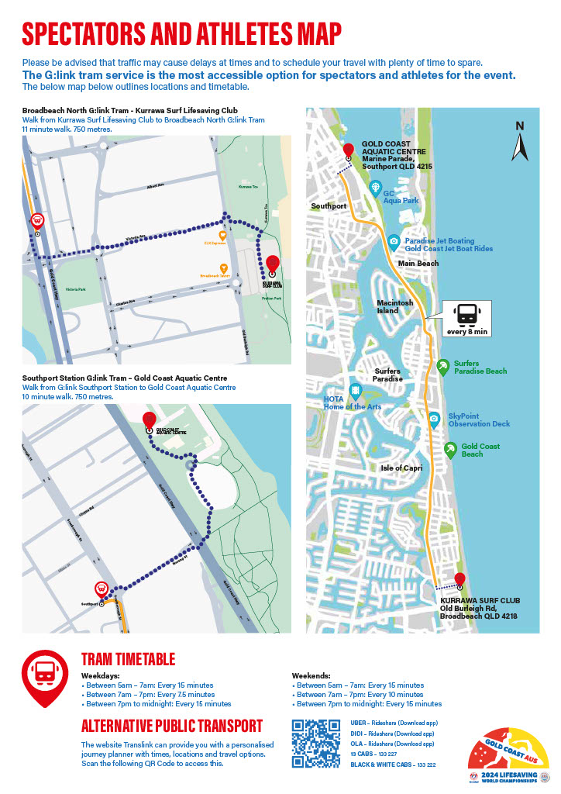

Slide 13
Daily Ocean Programme when Officiating
06h00 - Safety Meeting for EMC, Safety Officers and Referees and Sectional Referees in the Kurrawa SLSC.
06h00 – Kurrawa SLSC (downstairs) will be open for coffee/tea and a light continental breakfast.
All TO’s to collect lunch pack and sign register.
Those TO’s who require radios please collect them.
06h45 – Team Manager briefing by Sectional Referee in their arena.
07h15 – Technical Officials briefing by Sectional Referee in their arena.
07h40 – Marshalling commences.
08h00 – Competition commences.
After last event, there is the de-brief in Kurrawa SLSC club in the downstairs members area.

Slide 14
Refreshments and Lunch Pack
At registration you will be given a small cool-bag.
On days you are officiating you will be served a light continental breakfast from 06h00 – coffee/tea, toast (and Vegemite!), fruit, etc.
You will also be issued with your lunch, morning and afternoon snack. Do not forget to bring along your cool bag to keep your lunch, etc. cool.
Water is available on the beach (Note: there is no bottled water), so bring your water bottle.
After the conclusion of competition each day there is an officials’ de-brief at the at Kurrawa SLSC (see also the “Functions” slide).

Slide 15

Competition Rules
World Water Safety INTERNATIONAL LIFE SAVING FEDERATION ILS COMPETITION RULE BOOK Rules, Standards and Procedures for Lifesaving World Championships, ILS-Sanctioned Competitions, and ILS Federation Competitions 2023 Edition (Effective 1 June 2023) Gemeenteplein 26, 3010 Leuven, Belgium Telephone: +32 16 89 60 60 Email: ils.hq@telenet.be Web: www.ilsf.org
The rules applicable to the Lifesaving World Championships are as set out in the ILS Competition Rule Book.
In addition to the Rule Book there have been 5 Technical Bulletins issued regarding the rules.
Note: there could be slight variations to your Federation rules
Note: Because of space the Beach Flags will most likely be held as A and B Finals of 8.
Suggestion: go through the Rule Book.
The Rule Book and Bulletins are all available on the ILS and LWC 24 websites.

Slide 16


LWC2024 - Handbook
This document sets out the specific rules, events and other information relating to the conduct of LWC2024.
This document is also on the ILS and LWC 2024 websites.
World Water Safety
INTERNATIONAL LIFE SAVING FEDERATION
LIFESAVING WORLD CHAMPIONSHIPS
GOLD COAST – QUEENSLAND - AUSTRALIA
HANDBOOK

Slide 17
Other Judging/Officiating Matters
Marshalling and Recording will be by the use of LiveHeats.
Please note that the safety boats in the water will also be designated judging boats with operators trained to observe events.
iPads etc. will be used to assist with judging.

Slide 18
Lycra Vests
Lycra vests must be worn by competitors and handlers in designated ocean events (as detailed in the ILS Competition Rulebook.
Competitors and handlers must wear the provided vests unless otherwise agreed with the EMC.
The colour of vests is Pink for both men and women.
Note: To assist with judging of some events (e.g. beach sprints, and IRB) competitors will be required to wear lane coloured vests.

Slide 19
Masters Oceanman/Oceanwoman & Relay Draws
The Masters LWC Oceanman and Oceanwoman draw has been undertaken by the ILS EMC. The Draw is:
    Swim
    Ski
    Board
This draw also applies to the Master’s Oceanman and Oceanwoman Relay events.

Slide 20
National Team Oceanman/Oceanwoman Draws
The National Teams Youth Oceanman and Oceanwoman Relay draw has been undertaken by the ILS EMC. The Draw is:
    Ski
    Swim
    Board
The National Teams Open Oceanman and Oceanwoman Relay draw has been undertaken by the ILS EMC. The Draw is:
    Swim
    Ski
    Board
Note: The National Teams Open and Youth Oceanman, Oceanwoman are conducted as Ocean M events. The Ocean M and Ocean M Lifesaver Relay courses are all a fixed water draw of Swim, Board and Ski.
Please refer to the ILS Competition Rule Book and the LWC2024 Handbook for details.

Slide 21
Interclub Oceanman/Oceanwoman Draws
The Interclub Youth Oceanman and Oceanwoman Relay draw has been undertaken by the ILS EMC. The Draw is:
    Swim
    Board
    Ski
The Interclub Open Oceanman and Oceanwoman Relay draw has been undertaken by the ILS EMC. The Draw is:
    Board
    Ski
    Swim
Note: The Interclub Open and Youth Oceanman, Oceanwoman are conducted as Ocean M events. The Ocean M and Ocean M Lifesaver Relay courses are all a fixed water draw of Swim, Board and Ski.
Please refer to the ILS Competition Rule Book and the LWC2024 Handbook for details.

Slide 22
Ocean M and Ocean M Lifesaver Relay
The Men and Women Ocean M and the Mixed Ocean M Lifesaver Relay are the events that ILS are targeting to gain admittance as a sport into the 2032 Olympic Games.
As with LWC2022 it is imperative that these events and the athletes are showcased in the best light to the the IOC, the AOC, the Brisbane 2032 Olympic organisers and to the world.
Showcasing include the professional “dressing” of the green and gold arena at Kurrawa to best present the events particularly on the days that the LWC 2024 competition is being livestreamed and recorded at the beach.
The event presentation will also include achieving a “clean beach” where the athletes are the prime focus.
This means that the role of handlers will be limited to placing craft in the arena before the commencement of competition, then being located to the side of the arena, and a single handler entering the arena only to remove craft immediately at the conclusion of each craft leg.
The presence of officials on the competition arena will also be very limited and will be managed by the EMC and the Chief Referee.
Please assist by immediately following the instructions of the EMC when requested. The cooperation of all will significantly assist ILS and will be appreciated.

Slide 23
Opening of the Championships
For each LWC (e.g. Masters, Interclub, Surf Boats, etc), there will be an opening of the Championships.
The format is that the Commentator will declare the Championships open and playing the ILS hymn.
The National Teams Open and Youth LWCs Opening Ceremonies will be encompassed in the LWC 2024 Grand Opening Ceremony Commencing at 15h30 on Tuesday, 27 August 2024.
All Officials are encouraged to participate in this parade. If able please assemble with you fellow officials in Victoria Park at 15h00 ready to parade about 400m along the Victoria Street Mall to Kurrawa Green, for the ceremony that commences at 16h00.

Slide 24
Opening Ceremony Parade

Slide 25
Equipment and Scrutineering
Competitors must use the supplied manikins, rescue tubes and IRBs in events.
Competitors may use the own boards and skis, paddles, fins and surfboats in events.
There is also a pool of boards and skis and paddles that competitors can use.
All competitor provided boards, skis, and fins used in the National Teams LWCs must be scrutineered before use in competition.
There is no compulsory scrutineering of competitor provided commitment to be used in Interclub and Masters LWCs. However, competitors may have their equipment scrutineered if they so wish.
For Surf Boats a safety check will occur before the boats are taken onto the beach.
A scrutineering area will be set up at the ocean venue for craft, fins and boats and will be open before and during the competition.
Fins can also be scrutineered at the pool venue outside of marshalling and will be open before and during the competition.
Random scrutineering may also occur at any time at the discretion of the officials.

Slide 26
Protests and Appeals
Protests and Appeals are permitted on the basis detailed in the ILS Competition Rulebook and LWC2024 Handbook.
Appeal forms will be available from the Competitor Liaison Officials. Teams may also present forms printed from the ILS Competition Rulebook
Appeals fees are AUD$200 for individual events and AUD$300 for team events.
Appeal fees must be paid in cash and before an appeal is heard. A receipt will be provided.
Fees are refunded if an appeal is upheld.

Slide 27
Complaints/Comments
If you have any complaint or comment regarding any official, your first contact should be with the Chief Referee of the LWC.
Any other complaints/comments can be addressed to the Chairman of the ILS Sport Commission, Dave Thompson or the Secretary of the Sport Commission, Jelle Meintsma.
The Ocean Competition Committee Chair Greg Allum will also be available to assist particularly if Jelle or Dave are not immediately available.

Slide 28
Safety - Overview
It is compulsory that that all Officials undertake the Safety Induction before arriving on the Gold Coast for the LWC.
If not already completed download here.
When registering at LWC2024 and receiving your accreditation, etc., you will be required to acknowledge your completion of the Safety Induction.
You will also receive a daily safety briefing from your Referee.
Detailed Safety and Contingency Plans have been prepared for the LWCs. These may be found on the LWC Website.
These Plans have been discussed, agreed and signed off with the Local Authorities, the LOC and the ILS EMC.

Slide 29
Safety – Plans and Procedures
Prior to competition each day, risk assessments will be made at the beach to assess the competition site areas and safety maters including weather, surf conditions, air and water temperature, wind chill, and environmental matters, etc.
These assessments will be presented to the ILS Event Management Committee (EMC) to determine the progress of competition. Further assessments may be undertaken each day as required for consideration by the ILS EMC and Chief Referee.
Any decision to change the competition program for safety reasons will be as determined by the LWC Event Management Committee upon advice from the ILS Safety Officer.
There there will be Safety Officers rostered for each area. These Safety Officers will work with the Area Referees.
There will be the further support of lifeguards and first aid in each arena.
It is also planned that there will be a minimum of two IRB’s and one RWC as for each area. These boats will be designated as safety boats as well as “judge in boat” for officiating purposes.

Slide 30
Safety – LWC Weather and Surf Predictions
During LWC 2024 the weather should be stable, relatively mild and dry but sometimes a bit windy. The average air temperature should range from 16 - 25C (60 – 77 F).
The sea temperature will be around 22 C (71 F) and, on average, the surf conditions should be more stable than at other times of the year. Except for the IRB competition, wetsuits will not be permitted to be worn in swim legs of events.
Regular assessments of weather and surf conditions will also be undertaken during the day by the Safety Officer and will be considered and, as appropriate, acted upon by the LWC Event Management Committee.
Information will be conveyed to Team Managers and Officials at pre competition meetings and updates will be advised as necessary.
Please stay alert for all communications including briefings, messaging, and PA announcements.

Slide 31
Safety – Reporting Safety Issues
For each ocean and beach arena the first point of contact will be the Sectional Referee, the Liaison Officer, and the Area Safety Officer.
Please ensure that you report all matters of safety concern so that they can be addressed.
All safety concerns will be taken seriously and reviewed even if it means pausing competition.
Note: If it is a dire situation any Official can act to immediately stop competition and commence the safety operation process.

Slide 32
Safety – Incident Response
In case an incident occurs at the beach or in the ocean, it will be handled as per the Emergency Management Plan.
The Safety Plans contain detailed information about a range of scenarios and possible incidents and how to manage each event.
Each life-threatening situation will be directed to the Safety Officer and local Emergency Services and will follow the local procedures.
Non life threatening situations will be assessed by the Safety Officer/First Aid Team as appropriate and the patient may be treated at the First Aid Post, transported to main First Aid area and/or dispatched for further medical treatment as directed by the medical officers in attendance.

Slide 33
Safety – Contingency Plans
Should there be a serious safety concern reported or noted, competition will be paused, and the situation will be reviewed before competition resumes.
If necessary, the EMC will be called together to decide how best to proceed.
Localized relocation, rescheduling and event rationalization may be used to allow the Championships to continue.
Relocation to an alternative venue will only be considered as a last resort. The identified contingency site for Ocean events is North Kirra beach on the southern end of the Gold Coast about 20 kms from Kurrawa. While for Pool events it is the public 50m pool at the Gold Coast Aquatic Centre.
Communication will be via briefings, messaging, and PA announcements.,

Slide 34
Safety - Water
If a competitor appears to be in difficulty and/or signals for assistance the safety crew will respond.
If a competitor is taken from the water because they are injured or for their own safety, they will be brought to shore and assessed by a mobile first aid team. Further treatment may be appropriate.
The LWC medical team can also decide to remove a competitor from further competition for their own safety.
Any ski, paddles or boards, etc. will also be removed from the competition arena.
Any competitors at a buoy as part of a teams race will usually make their own way to shore.

Slide 35
Safety – First Aid
First Aid provision at LWC2024 is expansive with trained medical professionals on hand.
The main Medical Centre and Emergency Control Centre are both located in demountable buildings in the park to the south of Kurrawa SLSC with direct access to Old Burleigh Road.
There will also be a first aid tent at each water and beach area.
First aid services on the beach will be mobile during the events with first aid certified personnel and lifeguards in each water arena.

Slide 36
Functions
Wednesday, 21st August 2024: Masters and Technical Officials welcome at the Kurrawa Festival Zone at 17h00 (user pay)
Tuesday, 27th August 2024: Opening Ceremony at 16h00.
Note: The National Teams will form part of the march-on and officials are encouraged to participate.
Wednesday, 28th August 2024: ILS Gala Dinner at the Sofitel Hotel All welcome on a user pay basis – refer to the LWC2024 website to book.
Monday, 2nd September 2024: Technical Officials Thank You Function: Kurrawa.
Following the conclusion of daily competition there will be an Officials debrief in the downstairs area of Kurrawa SLSC.
Note: Debrief functions will not be held on the evenings of the Opening Ceremony, Gala Dinner and Officials Thank You function.
For each LWC there will also be a (user pay) closing party for participants. The starting times and confirmation of locations will be advertised once the competition programmes have been finalised.

Slide 37
Officiating
The Lifesaving World Championships are an international event with lifesavers from all around the world being in attendance. We have Technical Officials from 29 countries officiating. Approximately 55% are Australians (which is understandable given the location).
Please note that a number non-Australian Technical Officials may not be familiar with Kurrawa and the beach, so if they appear to be “lost” please assist them.
For a number of officials, competitors, and team management, their first language may not English, so please speak slowly, and do not use slang or abbreviations.
Some international officials may not be familiar with the way LWCs are conducted, so please assist them and, if possible, guide them.
Please make all officials welcome and make them feel part of the LWCs.
And please remember, we all have something to contribute, and that we can all learn from others.

Slide 38
Conclusion
Should you have a question about any aspect of this briefing please contact Jelle Meintsma, ILS Sport Commission Secretary, at meintsmaj@gmail.com. Your enquiry will be forwarded to the responsible person for response.
Once again, thank you for attending and being part of the Lifesaving World Championships.
We look forward seeing you on the beach and at the functions.
Click to Confirm Completion

