Slide 1
LIFESAVING WORLD CHAMPIONSHIPS 2024
TECHNICAL OFFICIALS BRIEFING – Pool

Slide 2
The ILS Event Management Committee and the Local Organising Committee records their appreciation and thanks you for officiating at the Lifesaving World Championships (LWC) 2024 Gold Coast, Queensland Australia
WELCOME

Slide 3
ILS Event Management Committee
Dave THOMPSON – Chairman
Jelle MEINTSMA – Secretary
Greg ALLUM – Ocean Championships
Perry SMITH – Pool Championships
Wim NUYENS – LifeHeats, Entries and Results
For any assistance, questions or enquiries – Please ask

Slide 4
LWC 2024: Local Organising Committee
Ron RANKIN – Chair and Project Director
Jacqui TAYLOR – Event Manager
Craig WILLIAMS – Assistant Event Manager/Pool Technical Advisor
Allan INWOOD - Ocean Technical Advisor
Ken BIRD – Site Manager & Logistics
Steve LEAHY – Director Safety & EMS
Nathan FIFE – Deputy Director Safety & EMS

Slide 5
Pool Referees and Senior Officials
 | MASTERS POOL | NT SERC | NT POOL | IC SERC | IC POOL
CHIEF REFEREE | Jo TEAGLE | Rebecca BOYD | Jerry POLESEL | Clare McGRATH | Jürgen BONNEMANN
DEPUTY CHIEF REFEREE | Hugo RODRIGUES Michelle WEEDY | Anni GARDINER Clare McGRATH | Anni GARDINER Bob DEKKERS | Rebecca BOYD Anni GARDINER | Stephanie ANDREWS Rebecca BOYD
EVENT DIRECTOR | Thomas PASSING Claudia KUNTZ | Johnny CLOUGH | Shanna REID Wolfgang DRAAIJER | Thomas PASSING Michelle WEEDY | Falk ODRICH
LIAISON | Barbara MORGAN Stephanie ANDREWS | Stephanie ANDREWS Thomas PASSING Roz GREY | Stephanie ANDREWS Karyn LOCKE Vijay Kumar SAH | Marni BLACK Karyn LOCKE | Roz GREY Adriana BLASIAK
APPEALS COMMITTEE CONVENOR | Geoff GREY | Geoff GREY | Joanne TEAGLE | Barbara MORGAN | Geoff GREY

Slide 6
Other Officials
The appointment of the remaining positions are on the LWC 2024 website. There have been some changes, and the appointment schedules will be updated.

Slide 7
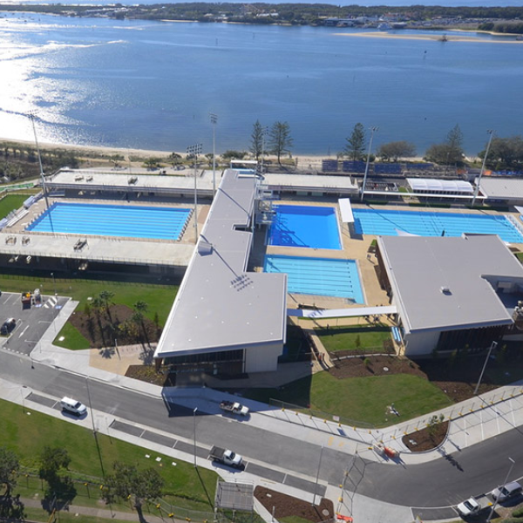
Gold Coast Aquatic Centre

Slide 8
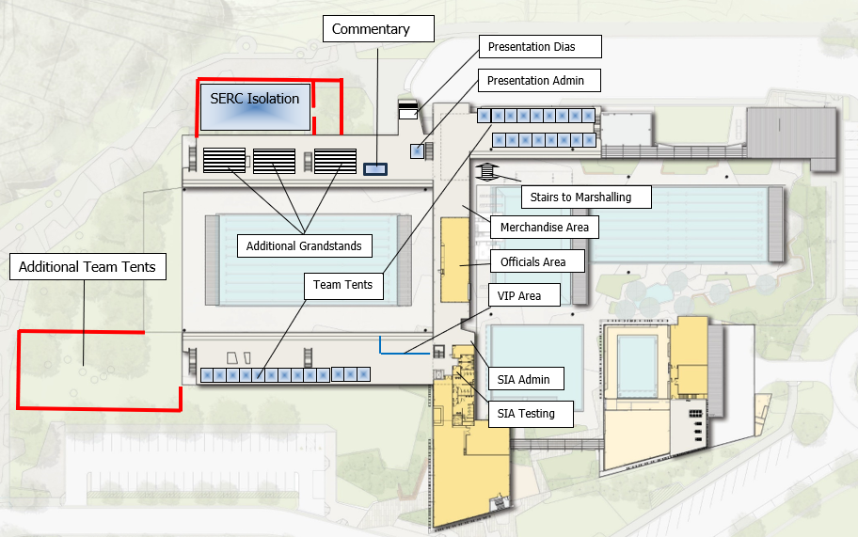
Pool Layout

Slide 9
ILS ANTI-DOPING POSITION
ILS shares the World Anti-Doping Agency (WADA) vision of a world where athletes can participate in a doping-free sporting environment.
ILS and its member federations/organisations are committed to adhere to WADA Standards and seeks to provide a clean, safe, and fair sporting environment.
A key principle of WADA’s World Anti-Doping Code International Standard for Education (ISE) is that the first encounter with clean sport and anti-doping should be for all athletes to be educated before being tested.
To this end ILS provides comprehensive information and education advice to its members via its website.
Sport Integrity Australia (SIA), a WADA recognised National Anti-Doping Agency, will be present during these Championships and, in line with WADA standards, there may be both random and targeted anti-doping testing in all 2024 LWCs. Note: For the World Games in 2025 and for LWC2026 ILS will require national teams to have undertaken formal anti - doping education prior to participation in competition.

Slide 10
Blue Cards
The Queensland Government has enacted legislation with the purpose that “all children under the age 18 years have a right to be safe and protected from harm”.
The “Blue Card” system contributes to the creation of safe service environments for children and includes a check on all adults who will work with children for seven days or more in a calendar year. This timeframe includes all ILS and SLS activities in Queensland including LWC2024.
All Australian Officials and Team Management at LWC2024 should have obtained a Blue Card. This requirement will be checked by the Local Organising Committee (LOC) as part of your registration at LWC2024.
If not already obtained, please arrange ASAP and, if possible, please ensure you have your blue card number when registering at LWC2024.
For non-Australian Team Management, the Local Organising Committee has requested a declaration from their Federation to ILS that their members are “safe” to work with children. The LOC has a record of these declarations.

Slide 11
Transport to the Gold Coast Aquatic Centre
There is a free daily bus service to transport officials along the Gold Coast Highway from Kurrawa Beach to the Gold Coast Aquatic Centre – see official newsletters.
There is also excellent public transport including trams and buses between Kurrawa Beach and the Pool – please see the next slide for details.
The public transport fares are minimal (AUD 50c).
To use public transport, you can either use your credit/debit card or purchase a Translink “go Card” (available at airports, convenience stores etc).
Please note there is limited parking at the pool and parking fees apply.

Slide 12
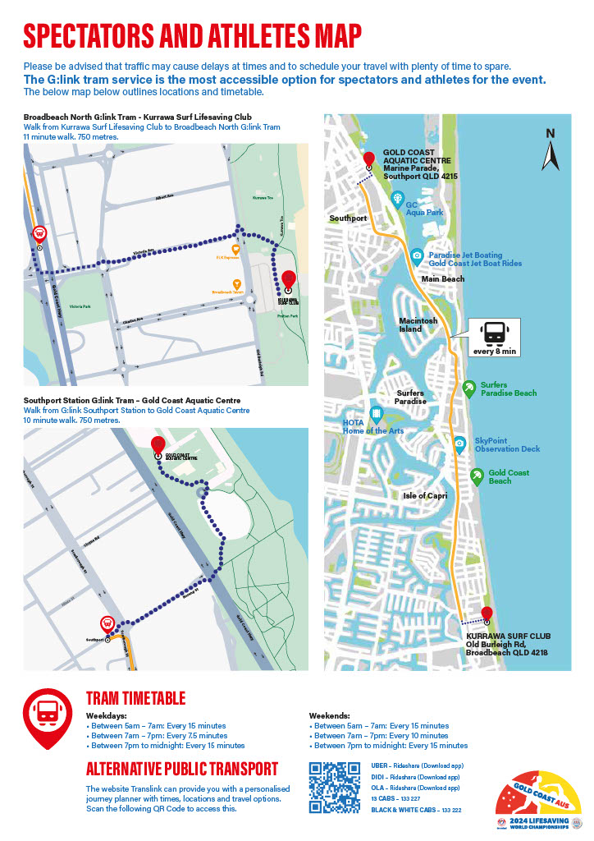

Slide 13
Daily Pool Programme when Officiating
Please for the daily programme refer to the LWC website
6h00 Bus to the Pool leaves Kurrawa SLSC
6h30 Breakfast is available at the pool
06h30 – Warm up commences in competition pool
o6h45 – Team Manager briefing by Referee.
07h30 – Marshalling commences.
08h00 – Competition commences.
Medal presentations will take place either progressively and/or at the conclusion of competition.

Slide 14
Breakfast, Lunch, and Refreshments
On days you are officiating you will be served a light continental breakfast at the pool from 06h30 – coffee/tea, toast (and Vegemite!), fruit, etc.
Lunches will be brought to the pool mid-morning each day and will be either be available during a break in the programme or brought to the pool deck for you
You may also choose to use the cool-bag given to you at registration to store your snacks and drinks. Do not forget put the freezer pack in your refrigerator each night and bring both with you each day.
Water is available on the pool deck (Note: there is no bottled water) so bring your water bottle.
After the conclusion of competition each day there is an officials’ de-brief at the pool as well as at Kurrawa SLSC (see also the “Functions” slide).

Slide 15
Competition Rules
World Water Safety INTERNATIONAL LIFE SAVING FEDERATION ILS COMPETITION RULE BOOK Rules, Standards and Procedures for Lifesaving World Championships, ILS-Sanctioned Competitions, and ILS Federation Competitions 2023 Edition (Effective 1 June 2023) Gemeenteplein 26, 3010 Leuven, Belgium Telephone: +32 16 89 60 60 Email: ils.hq@telenet.be Web: www.ilsf.org
The rules applicable to the Lifesaving World Championships are as set out in the ILS Competition Rule Book.
In addition to the Rule Book there have been 5 Technical Bulletins issued regarding the rules.
Note – there could be slight variations to your Federation rules.
Suggest go through the Rule Book.
The Rule Book and Bulletins are all available on the ILS and LWC 24 websites.

Slide 16
LWC2024 - Handbook
This document sets out the specific rules, events and other information relating to the conduct of LWC2024.
This document is also on the ILS and LWC 2024 websites.
World Water Safety
INTERNATIONAL LIFE SAVING FEDERATION
LIFESAVING WORLD CHAMPIONSHIPS
GOLD COAST – QUEENSLAND - AUSTRALIA
HANDBOOK

Slide 17
Equipment and Scrutineering
Competitors must use the supplied Manikins, Rescue Tubes, and line Throw ropes in events.
Competitors must supply and use their own Swim Fins.
All supplied equipment is compliant with ILS specifications
Swim fins are to be scrutineered before use in competition.
Fins will be scrutineered at the pool outside of marshalling and will be open before and during the competition.
The scrutineering area at the ocean venue will also be able to check swim fins before and during competition.
Random scrutineering may also occur at any time at the discretion of the officials.

Slide 18
Opening of the Championships
For each LWC (e.g. Masters, Interclub, Surf Boats, etc), there will be an opening of the Championships.
The format is that the Commentator will declare the Championships open and playing the ILS hymn.
The National Teams Open and Youth LWCs Opening Ceremonies will be encompassed in the LWC 2024 Grand Opening Ceremony Commencing at 15h30 on Tuesday, 27 August 2024.
All Officials are encouraged to participate in this parade. If able please assemble with you fellow officials in Victoria Park at 15h00 ready to parade about 400m along the Victoria Street Mall to Kurrawa Green, for the ceremony that commences at 16h00.

Slide 19
Opening Ceremony Parade

Slide 20
Protests and Appeals
Protests and Appeals are permitted on the basis detailed in the ILS Competition Rulebook and LWC2024 Handbook.
Appeal forms will be available from the Competitor Liaison Officials. Teams may also present forms printed from the ILS Competition Rulebook
Appeals fees are AUD$200 for individual events and AUD$300 for team events.
Appeal fees must be paid in cash and before an appeal is heard. A receipt will be provided.
Fees are refunded if an appeal is upheld.

Slide 21
Complaints/Comments
If you have any complaint or comment regarding any official, your first contact should be with the Chief Referee of the LWC.
Any other complaints/comments can be addressed to the Chairman of the ILS Sport Commission, Dave Thompson or the Secretary of the Sport Commission, Jelle Meintsma.
Alternatively, the Competition Committee Chair at the pool Perry Smith will assist if Jelle or Dave are not immediately available.

Slide 22
Safety - Overview
It is compulsory that that all Officials undertake the Safety Induction before arriving on the Gold Coast for the LWC.
If not already completed download here.
When registering at LWC2024 and receiving your accreditation, etc., you will be required to acknowledge your completion of the Safety Induction.
You will also receive a daily safety briefing from your Referee.
Detailed Safety and Contingency Plans have been prepared for the LWCs. These may be found on the LWC Website.
These Plans have been discussed, agreed and signed off with the Local Authorities, the LOC and the ILS EMC.

Slide 23
Safety – LWC Weather
During LWC 2024 the weather should be stable, relatively mild and dry but sometimes a bit windy. The average air temperature should range from 16 - 25C (60 – 77 F).
The competition & warm up/down pools are heated and will be around 28 C (82 F).
At the pool regular assessments of weather and the pool condition will be undertaken during the day by the Safety Officer and Lifeguards on duty. These will be considered and, as appropriate, acted upon by the LWC Event Management Committee.
Information will be conveyed to Team Managers at pre competition meetings and updates will be advised as necessary.
Please stay alert for all communications including briefings, messaging, and PA announcements.

Slide 24
Safety – Plans and Procedures
Prior to competition each day, risk assessments will be made at the pool to assess the competition site as well as safety including weather, pool conditions, air and water temperature, wind chill, and environmental matters, etc.
These assessments will be presented to the ILS Event Management Committee (EMC) to determine the progress of competition. Further assessments may be undertaken each day as required for consideration by the ILS EMC and Chief Referee.
Any decision to change the competition program for safety reasons will be as determined by the LWC Event Management Committee upon advice from the ILS Safety Officer.
At the pool lifeguards will be on deck to provide the water safety and first aid.

Slide 25
Safety – Reporting Safety Issues
At the pool the first point of contact will be the Chief Referee, the Liaison Officer, the Safety Officer and/or the lifeguards on pool deck.
Please ensure that you report all matters of safety concern so that they can be addressed.
All safety concerns will be taken seriously and reviewed even if it means pausing competition.
Note: If it is a dire situation any Official can act to immediately stop competition and commence the safety operation process.

Slide 26
Safety – Incident Response
In case an incident occurs at the pool, it will be handled as per the Emergency Management Plan which acknowledges the GCAC Emergency Management Plan.
The Emergency Management Plans contain detailed information about a range of scenarios and possible incidents and how to manage each event.
Any life-threatening situation will be directed by GCAC staff who will also be responsible for engaging Emergency Services where required.
Non life threatening situations will be assessed by the Pool Lifeguards as appropriate and may be referred for further medical treatment. Dispatch by ambulance will be at the discretion of the pool Lifeguards.

Slide 27
Safety – Contingency Plans
Should there be a serious safety concern reported or noted, competition will be paused, and the situation will be reviewed before competition resumes.
If necessary, the EMC will be called together to decide how best to proceed.
The most likely response will be to reprogram or rationalise events. Relocation to the 50m public pool would only be considered in the event of a catastrophic failure involving the competition pool.
Communication will be via briefings, messaging, and PA announcements.

Slide 28
Safety - Water
If a competitor appears to be in difficulty and/or signals for assistance the pool lifeguards will respond.
If a competitor is taken from the water because they are injured or for their own safety, they will be brought to pool side and assessed by the lifeguards. Further treatment may be appropriate.
The LWC medical team can also decide to remove a competitor from further competition for their own safety.

Slide 29
Safety – First Aid
First Aid provision at LWC2024 is expansive with trained medical professionals on hand.
The main Medical Centre and Emergency Service Office are both located in demountable buildings in the park to the south of Kurrawa SLSC with direct access to Old Burleigh Road.
At the pool the First Aid room will be utilised.
First aid services at the pool will also be available during the events with first aid certified lifeguards and other personnel and on hand.

Slide 30
Functions
Wednesday, 21st August 2024: Masters and Technical Officials welcome at the Kurrawa Festival Zone at 17h00 (user pay)
Tuesday, 27th August 2024: Opening Ceremony at 16h00. Note: The National Teams will form part of the march-on and officials are encouraged to participate.
Wednesday, 28th August 2024: ILS Gala Dinner at the Sofitel Hotel All welcome on a user pay basis – refer to the LWC2024 website to book.
Monday, 2nd September 2024: Technical Officials Thank You Function: Kurrawa
Following the conclusion of daily competition there will be an Officials debrief at the pool as well as the downstairs area of Kurrawa SLSC. Note: Debrief functions will not be held on the evenings of the Opening Ceremony, Gala Dinner and Officials Thank You function.
For each LWC there will also be a (user pay) closing party for participants. The starting times and confirmation of locations will be advertised once the competition programmes have been finalised.

Slide 31
Officiating
The Lifesaving World Championships are an international event with lifesavers from all around the world being in attendance. We have Technical Officials from 29 countries officiating. Approximately 55% are Australians (which is understandable given the location).
Please note that a number non-Australian Technical Officials may not be familiar with the Gold Coast, so if they appear to be “lost” please assist them.
For a number of officials, competitors, and team management, their first language may not English, so please speak slowly, and do not use slang or abbreviations.
Some international officials may not be familiar with the way LWCs are conducted, so please assist them and, if possible, guide them.
Please make all officials welcome and make them feel part of the LWCs.
And please remember, we all have something to contribute, and that we can all learn from others.

Slide 32
Conclusion
Should you have a question about any aspect of this briefing please contact Jelle Meintsma, ILS Sport Commission Secretary, at ils.hq@telenet.be. Your enquiry will be forwarded to the responsible person for response.
Once again, thank you for attending and being part of the Lifesaving World Championships.
We look forward seeing you on the beach and at the functions.
Click to Confirm Completion

